Slide 1
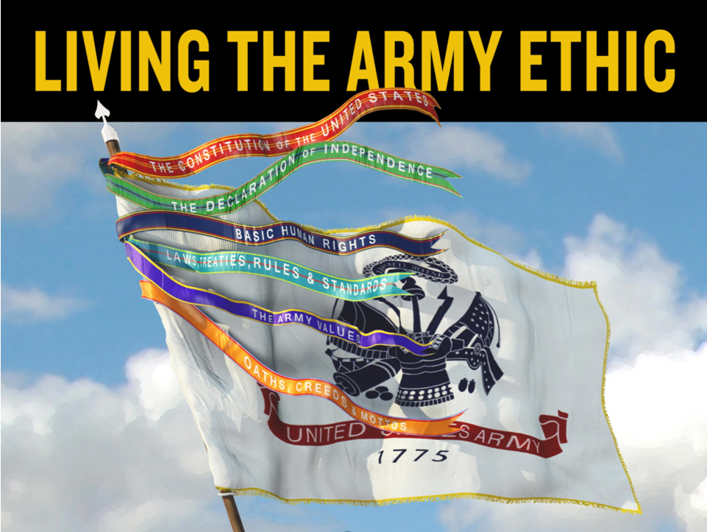

Slide 2
Learning Outcomes
Develop an understanding of the Army Ethic and its relation to Why We Serve.
Develop an understanding of the Army Profession’s shared identity, roles, and moral principles – How We Serve.
Explain why living the Army Ethic is important to develop mutual trust, internally and externally.
Apply the Army Ethic to the decisions and actions of Trusted Army Professionals.
Notes:
The Army Ethic. Our professional ethic is expressed in law, Army Values, creeds, oaths, ethos, and shared beliefs embedded within Army culture. It inspires and motivates the conduct of Army Professionals -- Soldiers and Army Civilians -- who are bound together in common moral purpose. It expresses the standard and expectation for all of us to make right decisions and to take right actions at all times. It is the heart of our shared professional identity, our sense of who we are, our purpose in life, and Why and How We Serve the American people.
Vision. As members of the Army Profession, we practice our profession, consistent with the Army Ethic, reflecting a shared understanding for Why and How We Serve in defense of the American people. As Trustworthy Army Professionals, we are Honorable Servants, Military Experts, and Stewards of the people and resources entrusted to our care.

Slide 3
The Army Ethic….
Explains the nature of honorable service in accomplishment of the mission, performance of duty, and all aspects of life.
Guides the Army Profession in the ethical design, generation, support, and application of landpower.
Establishes the standard and expectation for all to serve as Stewards of the Army Profession.
Inspires and motivates the conduct of Soldiers and Army Civilians who are bound together in common, moral purpose.
Expresses the standard and expectation for all of us to make right decisions and to take right actions. It is the heart of the Army and the inspiration for our shared professional identity – Who We Are – Trusted Army Professionals.
Notes:
The Army Ethic: Our professional ethic explains the nature of honorable service in accomplishment of the mission and performance of duty. It guides the Army Profession in the ethical design, generation, support, and application of landpower. It establishes the standard and expectation for all to serve as Stewards of the Army Profession. It is expressed in moral principles and Army Values; oaths and creeds; laws and regulations; and customs, courtesies, and traditions ‒ all embedded within the Army culture of Trust. It inspires and motivates the conduct of Soldiers and Army Civilians who are bound together in common, moral purpose. It expresses the standard and expectation for all of us to make right decisions and to take right actions. It is the heart of the Army and our shared identity ‒ our sense of who we are as Trusted Army Professionals ‒ in all aspects of life.
Additional Questions For Further Reference or to Support Discussion:
(Based on Chief of Staff of the Army The Army Ethic White Paper (11 July 2014) and ADRP 1 Chapter 2)
Q1. What is the Army Ethic?
A1. The Army Ethic is the heart of the Army Profession.
Every profession develops a code of ethical principles that guide the decisions and conduct of its members in the practice of their profession.
The Army Ethic is our professional ethic, the set of moral principles that guide our decisions and actions.
It is expressed in our laws, values, creeds, oaths, ethos, and shared beliefs, embedded within our Army culture.
It is the heart of our shared identity as Trusted Army Professionals, our sense of who we are, our purpose in life, and Why and How We Serve the American people.
Q2. Why is the Army Ethic important?
A2. It explains the nature of Honorable Service, for the Army, both as an institution and for each of us as members of the Profession.
The Army Ethic is more than just laws and regulations – those are the minimal acceptable standards of conduct. But those rules alone cannot guide your decisions and actions as an Army Professional – that takes having a clear concept of what is morally and ethically correct.
The Army Ethic motivates and guides the conduct of Army Professionals – Soldiers and Army Civilians – who are bound together in common, moral purpose.
It is absolutely essential that Army Professionals be strong in character, fully competent in their chosen career field, and committed to duty and mission accomplishment. That is because under Mission Command, they must understand the mission and commander’s intent and then use their professional judgment to make ethical, effective, and efficient decisions in accomplishment of the mission.
Q3. What is the purpose of publishing the Army Ethic in doctrine?
A3. Before June 2015, the Army did not have a clearly articulated, accessible, and commonly understood Army Ethic. In June 2015, the Army published an updated version of ADRP 1 (The Army Profession) which contained a new Chapter 2, a chapter that specifically explained the Army Ethic.
By publishing a written Army Ethic in doctrine, the Army increases shared understanding of the roles we fulfill as Trusted Army Professionals and moral principles that guide and inspire us to make right decisions and actions. Having a written ethic is a key element of any profession and binds the members of the profession together in common, moral purpose.
There have been many attempts over the past 239 years, by many authors, both officially and unofficially, to articulate the collection of our American values, oaths, ethos, laws, and shared beliefs that are embraced in our Army.
Many aspects of the Army Ethic have been passed down from the Continental Army through generations of Soldiers in our customs, courtesies, and traditions and preserved by our Army culture.
However, it was clearly understood that an unwritten Army Ethic would not be able to motivate, inspire, and guide the conduct of Army Professionals.
As we anticipate new ethical challenges emanating from rapidly advancing technology and a changing American culture, we now have a concise, easily understood, and universally applicable official expression of our ethic in Chapter 2 of ADRP-1, The Army Profession.
A second major reason for adding the Army Ethic to our doctrine is that it should inform the concept and drive the strategy for character development of our Army Professionals.
Q4. So what is the goal of having a published Army Ethic? What is the Army trying to accomplish?
A4. Our goal is a disciplined Army of professionals (Soldiers and Army Civilians).
We want self-disciplined people in our Army to use their professional judgment to make values-based decisions
to ethically, effectively and efficiently accomplish all missions,
to improve the ethical conduct of all members of our profession
while living their lives in an ethical manner
and upholding the Army Ethic to preserve our Trust with America
Q5. What does the Army Ethic mean to members of the Army Profession?
A5. Each Soldier and Army Civilian, when they swear or affirm their oath, morally commits themselves to live by our ethical principles.
To violate the Army Ethic is to break our sacred bond of trust with each other and those whom we serve.
Failure to live by the Army Ethic brings dishonor on us all and may have strategic implications for our mission.
Living by and upholding the Army Ethic strengthens our shared professional identity.
Q6. As Stewards of the Army Profession, what can you do to implement and support the Army Ethic?
A6. The most important action that any officer or NCO can take to establish an ethical command climate, that supports the Army Ethic, is to be a moral exemplary role model. Soldiers admire and want to emulate good leaders. Setting the example for others to follow is a basic principle of leadership. In addition, commanders must encourage coaching, counseling, mentoring while affording opportunities for education, and training that help develop the competence, character, and commitment of their subordinates as Army Professionals.
Q7. The America’s Army - Army Profession theme for FY 15 and 16 is “Living the Army Ethic.” What do we mean by Living the Army Ethic?
A7. All members of the Army Profession are expected to be trusted Army Professionals, who abide by and uphold the Army Ethic to be:
Honorable Servants of the Nation
Experts in the ethical application of landpower
Stewards of the Army Profession
Q8. So if the intent of the Army Ethic is to motivate and guide the conduct of Soldiers and Army Civilians on and off duty, is there an expectation that Veterans of Honorable Service will continue to live their lives by the Army Ethic?
A8. Absolutely, Army Professionals continue to be Soldiers for Life after completion of their Honorable Service to the Nation. It is the Army’s desire that when our Soldiers and Army Civilians return to society as private citizens, that they will continue to be moral-ethical exemplars for their extended Families and American communities. We want them to be the walking, talking role models, and spokespersons for our Army and for service to the Nation. In many ways, Veterans of Honorable Service and Army Retirees continue to contribute to the welfare of our Army and America.

Slide 4
http://cape.army.mil/videos/living-the-army-ethic-why-and-how-we-serve
Notes:
Students watch video and then give their reactions.

Slide 5
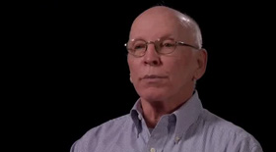
Why We Serve
We are committed to do our duty to contribute to the “common defense;” we share a love of country and our Army Family; we defend American values that frame the nation as expressed in the Declaration of Independence and the Constitution of the United States; and we serve “not to promote war, but to preserve peace.”
Love of Country and Family
Preserve the Peace – Prevent, Shape, Win
Defend the American People and Values
“Serving as an Army Civilian”
Notes:
OUR OBLIGATIONS AND ASPIRATIONS FROM THE ARMY ETHIC.
2-9. The legal and regulatory foundations of the Army Ethic are found in codified documents, such as the United States (U.S.) Constitution, the Uniform Code of Military Justice, and the U.S. Code of Federal Regulations. Institutionally, these and other codified parts of our ethic serve to establish the mission of the Army (ADP 1 discusses the mission of the Army). Individually, in the performance of duty, Army professionals must meet and uphold these standards. They establish the minimum norms for ethical conduct. Deliberate failure to meet these benchmarks violates the Army Ethic and may result in legal, regulatory, or administrative consequences.
2-10. In addition to the legal foundations, the Army Ethic includes higher standards from its moral foundations, such as those expressed in the Declaration of Independence. While the moral principles of the Army Ethic are not law or regulation, they establish the expectations to which we aspire institutionally as a profession and individually as trusted Army professionals. These are the inspirational and motivational foundations for honorable service.
2-11. Motivated by both the legal and moral foundations of the Army Ethic, Army professionals adhere to all applicable laws, regulations, or rules in the accomplishment of every mission, particularly in combat or in any application of lethal force. However, situations of uncertainty occur where the rules do not provide a clear, right course of action. In these cases, Army professionals base their decisions and actions on the moral principles of the Army Ethic, ensuring the protection of the inalienable rights of all people. In this way, Army professionals live by and uphold the moral foundation of the Army Ethic and reinforce the Army culture of trust among fellow Army professionals and with the American people.

Slide 6
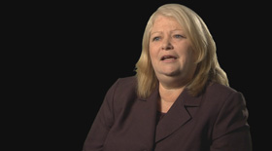
Why We Serve
“Serving Honorably”

Slide 7
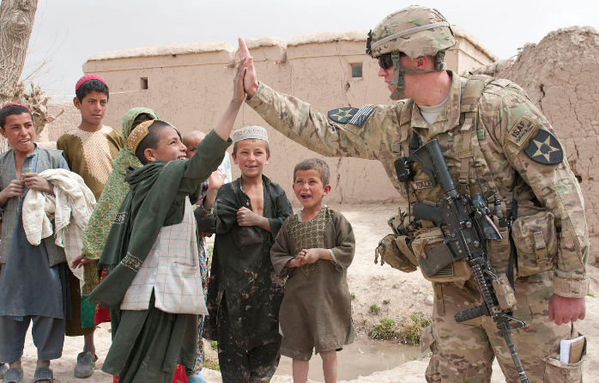
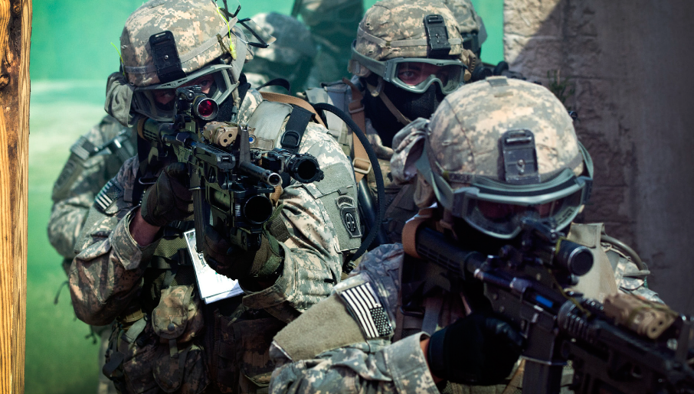
Preserve the Peace – Prevent, Shape, Win
Prevent conflict by deterring potential
adversaries and assuring allies and partners.
Shape the strategic, operational and
tactical environment to ensure the U.S.
maintains an advantage prior to conflict.
Win quickly and decisively in the event
of conflict.
Notes:
First, our Army must prevent conflict. Prevention requires a credible force with sufficient capacity, readiness and modernization. Our ability and will to win any fight cannot be open to challenge. As part of a joint force, we must be clear that we can fight and win across the full spectrum of conflict…
Second, our Army must help shape the international environment so our friends are enabled and our enemies contained. We do that by engaging with our partners, fostering mutual understanding through military-to-military contacts, and helping partners build the capacity to defend themselves…
Finally, we must be ready to win decisively and dominantly. If we do not, we pay the price in American lives... With so much at stake, the American people will expect what they have always expected of us: to never lightly enter into such a terrible endeavor, but once there to win and win decisively.
References: The Army Vision 2015-2025: Strategic Advantage in a Complex World, p. 2, accessed from the CSA’s homepage and CSA Editorial: Prevent, shape, win, December 16, 2011.

Slide 8
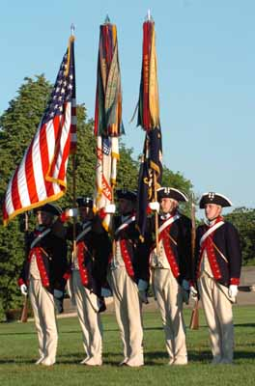
Defend American People and Values
The collective right of the American people to independence and political sovereignty is the moral basis for the Army mission.
Protecting our collective right is the service the Army Profession provides for our society.
We must not violate the rights of others or we violate our own ethic and erode trust and legitimacy.
The Army mission, as directed by our civilian leaders, justifies the ethical application of landpower, which could result in taking the lives of others and placing our own lives at risk.
Notes:
3-15. Important insights for all Army professionals about how and why we serve include the following:
The collective right of the American people to independence and political sovereignty is the moral basis for the Army mission.
Protecting our collective right is the service the Army Profession provides for our society.
As Army professionals, we must not violate the rights of others, or we violate our own ethic and erode trust and legitimacy.
The Army mission, as directed by our civilian leaders, justifies the ethical application of landpower.
The moral justification for the Army mission is the basis for taking the lives of others and courageously placing our own lives at risk.

Slide 9
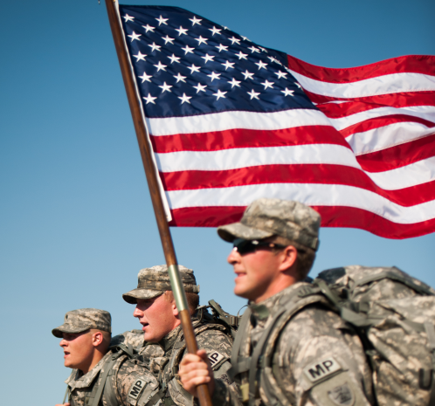
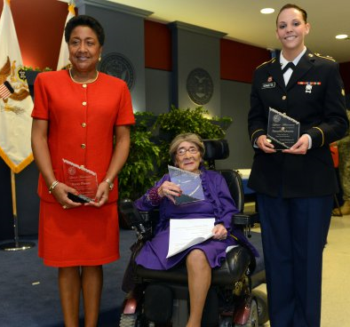
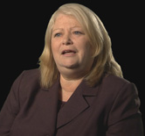
How We Serve
We live by and uphold the Army Ethic in the conduct of our mission, performance of our duty, and all aspects of our lives; and we practice the discipline of our military art and science, always striving for standards of excellence.
By our solemn oath, we voluntarily incur moral obligations inherent in the shared identity to which we aspire:
Trusted Army Professional
with complementary roles as
Honorable Servants,
Army Experts, and
Stewards of the Profession
“Serving as an Army Professional”
Notes:
ADRP 1
3-10. Understanding why and how we serve the American people is a functional imperative. Army professionals understand that their honorable service is noble and just. Otherwise, they may doubt the value of their service or question their commitment to the Army Profession.
3-11. Adherence to the Army Ethic, a moral obligation, is a force multiplier in all operations. Leaders are role models and must communicate and set the example for living the Army Ethic for their Soldiers and Army Civilians. By living and upholding the Army Ethic, we strengthen the essential characteristics of the Army Profession.
3-6. Army leaders, at all levels, are responsible for reinforcing the Army culture of trust and establishing a professional organization and command climate essential for mission command. ADRP 6-0 states that mission command is based on mutual trust and shared understanding and purpose. Operations under the philosophy of mission command require trust up and down the chain of command and left and right between units. Superiors trust subordinates and expect them to accomplish missions consistent with the commander’s intent. Subordinates trust superiors to give them the freedom to accomplish the mission with disciplined initiative.
5-21. Being an Army professional starts with developing and sustaining a Professional Identity. Identity refers to one’s self-concept. Army Professionals must first self-identify with being a member of the Army Profession. That identity is formed and preserved in accordance with the individual’s competence, character, and commitment to the Army Ethic.
A-9. Our shared professional identity as trusted Army professionals guides our decisions and actions, inspiring us to be honorable servants, Army experts, and responsible stewards of the Army Profession. We are committed to lifelong learning and professional development. We strive for standards of excellence in all our endeavors. We contribute our best effort to accomplish the mission and embrace a spirit of service to others before self.

Slide 10
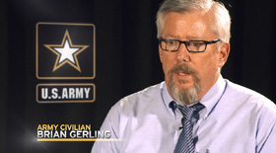
How We Serve as Trusted Army Professionals
Honorable Servants, Army Experts, and Stewards of the Profession have a responsibility to make right decisions and take right actions
Living and Upholding the Army Ethic
Right decisions and actions are ethical, effective, and efficient
Living and Upholding the Army Ethic
Living and Upholding the Army Ethic
Dedication to the Army Ethic: Demonstrated in
Decisions & Actions
Performance of Duty:
with Discipline &
to Standard
Character
Competence
Trust
Honorable Service
& Mission Accomplishment:
Despite
Adversity, Obstacles, & Challenges
Commitment
Mission Critical Video Case Study
Mission Command & Leader Development depend on the
Character, Competence, Commitment
of Army Professionals in the performance of Duty and all aspects of life
Notes:
2-26. The Army Ethic motivates and inspires our shared identity as trusted Army professionals. Preservation of the peace and winning the Nation’s wars is inherent to our ethos—this is Why We Serve. The ethical, effective, and efficient accomplishment of the mission is the core of our ethos—this is How We Serve.
3-2. The Army Profession has been successful in sustaining the respect and trust of the American people. However, this trust is fragile and easily damaged if we do not understand who we are, who we serve, why we serve, and how we serve. Essential to reinforcing trust is performing our duty every day in a manner that the American people judge to be ethical according to the beliefs and values enshrined in the Nation’s founding documents.
3-3. Within the Army, internal trust is reliance on the character, competence, and commitment of Army professionals to live by and uphold the Army Ethic. It serves as a vital organizing principle that establishes the conditions necessary for mission command. Trust is earned and reinforced as Army professionals contribute to the mission and perform their duty, seeking and communicating the truth and acting with integrity. With trust, there is less need for detailed guidance and close supervision.
3-4. Army professionals certified by these criteria develop mutual trust within cohesive teams.
Certification evaluates and assesses an Army professional’s—
Character: dedication and adherence to the Army Ethic, including Army Values, as consistently and faithfully demonstrated in decisions and actions.
Competence: demonstrated ability to successfully perform duty with discipline and to standard.
Commitment: resolve to contribute honorable service to the Nation and accomplish the mission despite adversity, obstacles, and challenges.
3-5. An Army professional’s store of trust develops from demonstrated character, competence, and commitment. Subordinates, peers, and superiors lose trust in a member of the Army Profession whose conduct fails to meet the standards of these criteria. More important, a greater loss of trust in the institution occurs when leadership neglects to take action to address these failures.
Taken from ADP 6-0: Mission Command:
2. The mission command philosophy of command is one of the foundations of unified land operations. Mission command is the exercise of authority and direction by the commander using mission orders to enable disciplined initiative within the commander’s intent to empower agile and adaptive leaders in the conduct of unified land operations. The mission command philosophy effectively accounts for the nature of military operations. Throughout operations, unexpected opportunities and threats rapidly present themselves. Operations require responsibility and decision making at the point of action. Through mission command, commanders initiate and integrate all military functions and actions toward a common goal—mission accomplishment.

Slide 11
Honorable Servants of the Nation – Professionals of Character
We serve honorably—according to the Army Ethic—under civilian authority while obeying the laws of the Nation and all legal orders; further, we reject and report illegal, unethical, or immoral orders or actions.
We take pride in honorably serving the Nation with integrity, demonstrating character in all aspects of our lives.
In war and peace, we recognize the intrinsic dignity and worth of all people, treating them with respect.
We lead by example and demonstrate courage by doing what is right despite risk, uncertainty, and fear; we candidly express our professional judgment to subordinates, peers, and superiors.
“Positive Work Environment”
Notes:
Honorable service: Our Noble Calling:
4-1:…Support and defense of the Constitution, the American people, and the national interest in a manner consistent with the Army Ethic. Throughout history, every military has had a distinct ethic and ethos that reflect the values and norms of the society it protected. The moral principles of the Army Ethic encompass American values and guide our approach to warfighting.
HONORABLE SERVICE
1-25. The Army exists as a profession for one reason: to serve the Nation by supporting and defending the Constitution in a way that upholds the rights and interests of the American people. This is the basis for the Army Ethic, which is the heart of the Army Profession. The Army Ethic defines what it means to serve honorably. Our professional responsibility is to daily contribute honorable service, living by and upholding the Army Ethic in the conduct of our mission, performance of duty, and all aspects of life.

Slide 12
Army Experts – Competent Professionals
We do our duty, leading and following with discipline, striving for excellence, putting the needs of others above our own, and accomplishing the mission as a team.
We accomplish the mission and understand it may demand courageously risking our lives and justly taking the lives of others.
We continuously advance the expertise of our chosen profession through life-long learning, professional development, and our certifications.
“The Army Civilian Corps”
Notes:
5-1. Military expertise is the ethical design, generation, support, and application of landpower, primarily in unified land operations, and all supporting capabilities essential to accomplish the mission in defense of the American people. Soldiers and Army Civilians will find within this definition the role their units and organizations play in ultimately applying landpower and how their own contribution fits into the larger mission.
2-20. The Army Value of duty charges us with the responsibility to contribute our best efforts to accomplish the mission as members of the team. In performing our duty, we make right decisions and take right actions to the best of our ability. This does not mean that we will always succeed or avoid all mistakes. Setbacks and error will occur in any human endeavor. We learn from experience, both good and bad, develop in wisdom and leadership, and strive for excellence.
2-21. The Army mission includes the directive to “fight and win our Nation’s wars.” We must be equipped, trained, and ready to engage in armed conflict. Our basic human rights, affirmed in the Declaration of Independence and stated in law, must be defended. Our right to life includes the right and the responsibility of self-defense. The legitimate interests of the American people, as determined by our freely elected government, must be protected when threatened or attacked. Our missions may justly require the use of armed force against legitimate threats, consistent with the Army Ethic. We recognize that our lives, and the lives and well-being of others, are at risk. In the fog of war, uncertainty compromises situational
understanding. Regardless, to the best of our ability, we must make decisions and take actions that are right. We understand there may be unanticipated, unintended consequences affecting the lives of innocent people and their property. We do all we can to avoid these effects. We accept prudent risk and with courage we accomplish the mission in the right way.
2-22. Within the Army Profession, progressive development and certification in character, competence, and commitment for Soldiers and Army Civilians is a continuous, life-long responsibility. Knowledge, discipline, and leadership require education, training, experience, coaching, counseling, and mentoring. Situational understanding requires our individual and collective wisdom and judgment, often under demanding, chaotic circumstances, to discern what is actually so—the truth. With shared understanding and intent, we evaluate our options, decide what is right, and work as a cohesive team to accomplish the mission.

Slide 13
Stewards of the Army Profession – Committed Professionals
We embrace and uphold the Army Values and standards of the profession, always accountable to each other and the American people for our decisions and actions.
We wisely use the resources entrusted to us, ensuring our Army is well led and well prepared, while caring for Soldiers, Army Civilians, and Families.
We continuously strengthen the essential characteristics of the Army Profession, reinforcing our bond of trust with each other and the American people
“Stewardship of the Army Profession”
Notes:
STEWARDSHIP OF THE PROFESSION
1-27. Stewardship is our duty to care for the people, other resources, and the profession entrusted to us by the American people. Our decisions and actions must be right, both for today and for tomorrow. All Army professionals have the duty to be faithful, responsible, and accountable stewards, advancing the Army Profession, strengthening the Army culture of trust, and conveying the legacy we inherited from those who led the way. Senior leaders, the Army’s senior stewards, have a special responsibility to ensure the present and future effectiveness of the Army.
Stewardship is an essential aspect of Army relationships:
Army STEWARDS create and sustain positive command climates, and ensure present and future development and effectiveness of the Profession’s members and resources
RESULTS: Reinforced Trust among Army Professionals and with the American people, and enhanced Esprit de Corps within the Army.
2-23. Every Soldier and Army Civilian has the opportunity to simultaneously be a leader, follower, and steward of the Army Profession. We are accountable to the American people to accomplish the mission in the right way. We accept responsibility for making right decisions and taking right actions, always. We hold others and ourselves accountable to achieve the standard, striving for excellence. All of us exemplify lifelong commitment to defend the American people and secure the national interest by performing our duty consistent with Army Values. We stand strong to uphold the Army Ethic and conduct ourselves in a manner worthy of our professional status.
2-24. We are diligent and faithful guardians of the people, other resources, and the profession entrusted to our care. The privilege to lead includes the responsibility to professionally develop our subordinates. We teach, coach, counsel, and mentor, and willingly accept such guidance from others. We develop people and organizations—ensuring they are properly equipped, trained, and led. We are ready for the mission today and anticipate the challenges that lie ahead. We exercise discipline in our use of materiel, facilities, and funds. We promote and safeguard the health and welfare of our Soldiers, Army Civilians, and their Families.
2-25. Our Army’s history confirms that well-led, disciplined organizations, embracing shared identity and purpose, succeed as a team. It also confirms that the Army is a military profession when it manifests its essential characteristics: honorable service, military expertise, stewardship, and esprit de corps, which together produce trust. While all Army professionals are stewards of the profession where they serve, our senior stewards have special responsibilities for the developmental policies, strategies, and resources that enable the Army’s professional status. By strengthening its essential characteristics, the Army reinforces trust within the profession and with society.

Slide 14
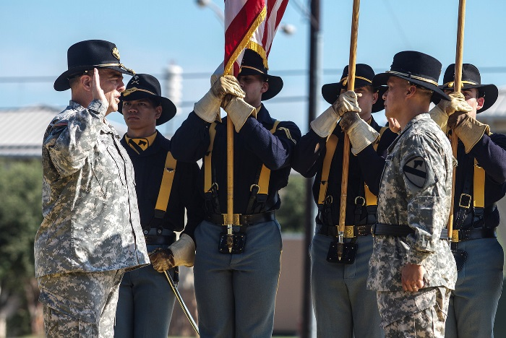
Expectations for Army Professionals
Seek to discover the truth, decide what is right (ethical, effective, efficient), demonstrate the character, competence, and commitment to act accordingly.
Contribute honorable service in the conduct of the mission, performance of duty, and all aspects of life.
Stand Strong as stewards in maintaining the Army Profession by upholding the Army Ethic—prevent misconduct and do what is right to stop unethical practices.
Notes:
2-26. The Army Ethic motivates and inspires our shared identity as trusted Army professionals. Preservation of the peace and winning the Nation’s wars is inherent to our ethos—this is Why We Serve. The ethical, effective, and efficient accomplishment of the mission is the core of our ethos—this is How We Serve.
2-27. We accomplish the mission as a team, Soldiers and Army Civilians, contributing our best effort, doing what is right to the best of our ability, and always striving for excellence. Leaders set the right example, live by and uphold the Army Ethic, establish a positive climate, and inspire the team. While the senior leader is responsible for what the team does or fails to do, success demands that all perform duty with discipline and to standard. In this way, leaders and followers are trusted teammates in the exercise of mission command. The consistent demonstration of character, competence, and commitment, with shared understanding and intent, reinforces mutual trust. Our Army’s primary role as an element of the joint force is in the land domain. Our enduring responsibility is to equip, train, and be ready for a wide variety of missions, as directed by the civilian and military chain of command.
2-28. Living by and upholding the Army Ethic is our life-long commitment. Reinforcing trust requires continuous professional development. This quest is a duty consistent with our shared identity. When our Soldiers and Army Civilians return to society as private citizens, they continue to be moral-ethical exemplars for their Families and communities. Every veteran of honorable service and Army retiree is a “Soldier for Life” and continues to contribute to the well-being of the United States of America.
3-4. Army professionals certified by these criteria develop mutual trust within cohesive teams. Certification evaluates and assesses an Army professional’s—
Character: dedication and adherence to the Army Ethic, including Army Values, as consistently and faithfully demonstrated in decisions and actions.
Competence: demonstrated ability to successfully perform duty with discipline and to standard.
Commitment: resolve to contribute honorable service to the Nation and accomplish the mission despite adversity, obstacles, and challenges.

Slide 15
Learning Outcomes Review
Develop an understanding of the Army Ethic and its relation to Why We Serve.
Develop an understanding of the Army Profession’s shared identity, roles, and moral principles – How We Serve.
Explain why living the Army Ethic is important to develop mutual trust, internally and externally.
Apply the Army Ethic to the decisions and actions of Trusted Army Professionals.
Notes:
The Army Ethic. Our professional ethic is expressed in law, Army Values, creeds, oaths, ethos, and shared beliefs embedded within Army culture. It inspires and motivates the conduct of Army Professionals -- Soldiers and Army Civilians -- who are bound together in common moral purpose. It expresses the standard and expectation for all of us to make right decisions and to take right actions at all times. It is the heart of our shared professional identity, our sense of who we are, our purpose in life, and Why and How We Serve the American people.
Vision. As members of the Army Profession, we practice our profession, consistent with the Army Ethic, reflecting a shared understanding for Why and How We Serve in defense of the American people. As Trustworthy Army Professionals, we are Honorable Servants, Military Experts, and Stewards of the people and resources entrusted to our care.

Slide 16
Your feedback is important for Strengthening the Army Profession!!
This Quick Reference Code can be smart-phone-scanned, or the link below it can be used to provide feedback on this America’s Army – Our Profession learning session.
http://cape.army.mil/aaopfeedback.html

Slide 17
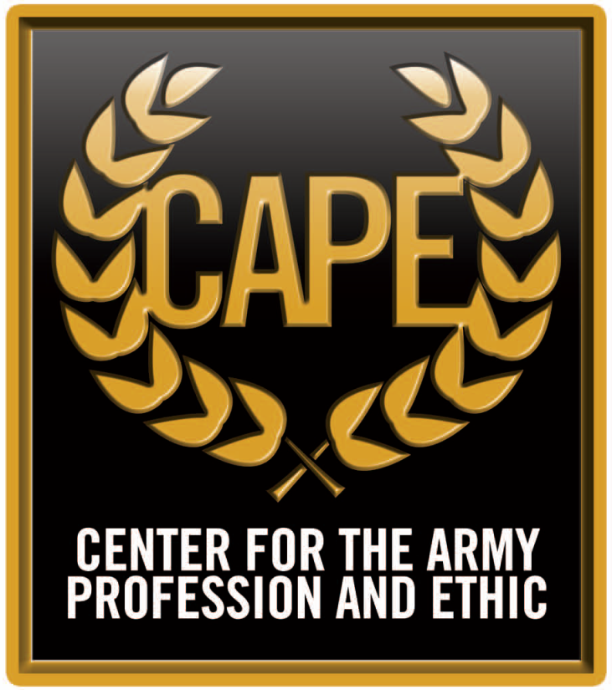
Visit us at http://cape.army.mil
Products and Materials for Development as Army Professionals

