Slide 1
Team Building
LP 158-IMT0005

Slide 2
Terminal Learning Objective (TLO)
Action: Perform leader actions for team building.
Conditions: Given ATP 6-22.6, Army Team Building (October 2015) and formal instruction in a classroom environment.
Standards:
Annotate the three phases of team building in the correct sequence.
Name the two types of teams.
Identify at least five indicators of effective teams.
Identify the types of team assessments in a clear and concise manner.
Learning Domain: Cognitive
Level of Learning: Understand

Slide 3
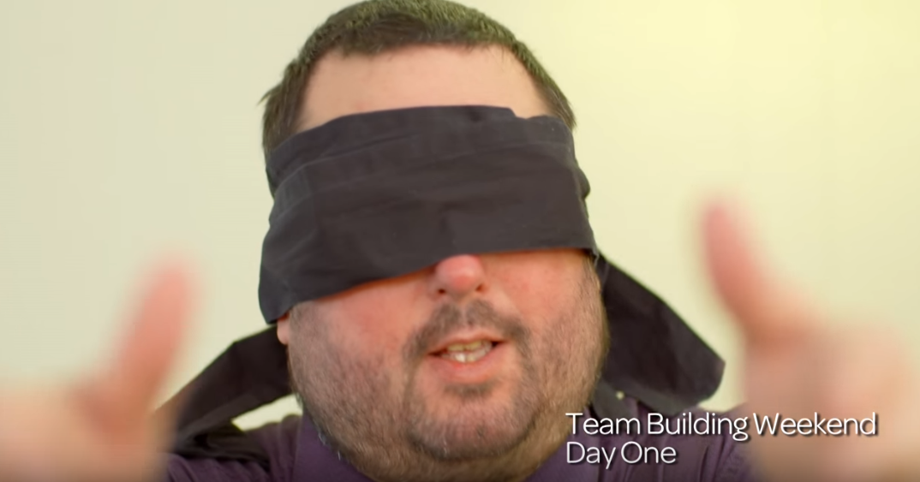
What if team-building was a matter of life and death?
Notes:
Play the video from https://www.youtube.com/watch?v=XYTwCE9msvY
Length 2:26
What if Team Building was a Matter of Life and Death?
* How accurate was the team leader’s assessment of the team?

Slide 4
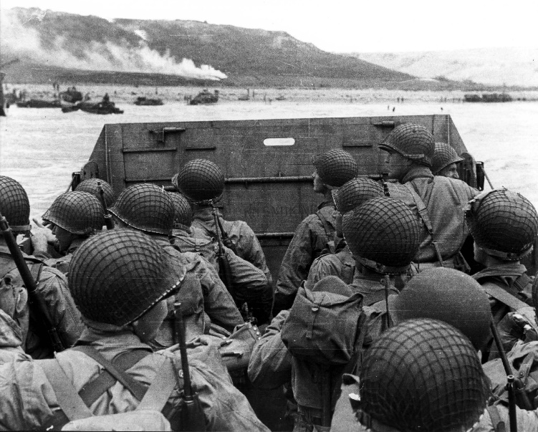
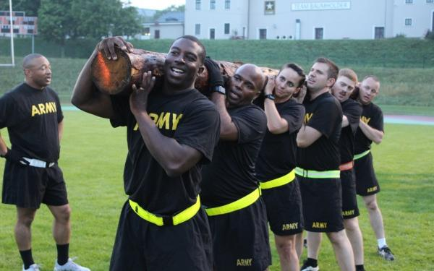
What is a Team?
A team is any group that functions together to accomplish a mission or perform a collective task
Army organizations rely on effective teams to complete tasks, achieve objectives, and accomplish missions
Teamwork is built on mutual trust and commitment to the team
Building teams is an essential skill for all Army Leaders
ATP 6-22.6 para 1-1-to 1-5

Slide 5
Types of Teams
The Army is a team of teams composed of numerous organizations with one overarching common mission: win the Nation’s wars.
Internal Teams
Made up of personnel from inside an organization
Internal team leaders have formal authority
Team members have distinct roles or specialties
Accomplish specific missions or tasks
Typically have an established structure
External Teams
Members come from different organizations
Members bring specific knowledge, skills, and attitudes
Mission, situation, and geographic location dictate team makeup
Team members generally don’t have authority over each other
Rely on strong relationships and mutual benefits
ATP 6-22.6 para 1-27 to 1-34

Slide 6
Team Member Roles and Responsibilities
Team Leaders
Establishing a positive climate
Creating a shared vision and team identity
Providing clearly stated goals
Establishing roles and responsibilities
Establishing an environment of collaboration and dialogue
Establishing an environment that embraces learning
Knowing the strengths and weaknesses of team members
Team Members
Building relationships
Demonstrating flexibility and adaptability
Cooperating with other team members
Having a willingness to help others
Respecting others
ATP 6-22.6 para 1-36 to 1-81

Slide 7
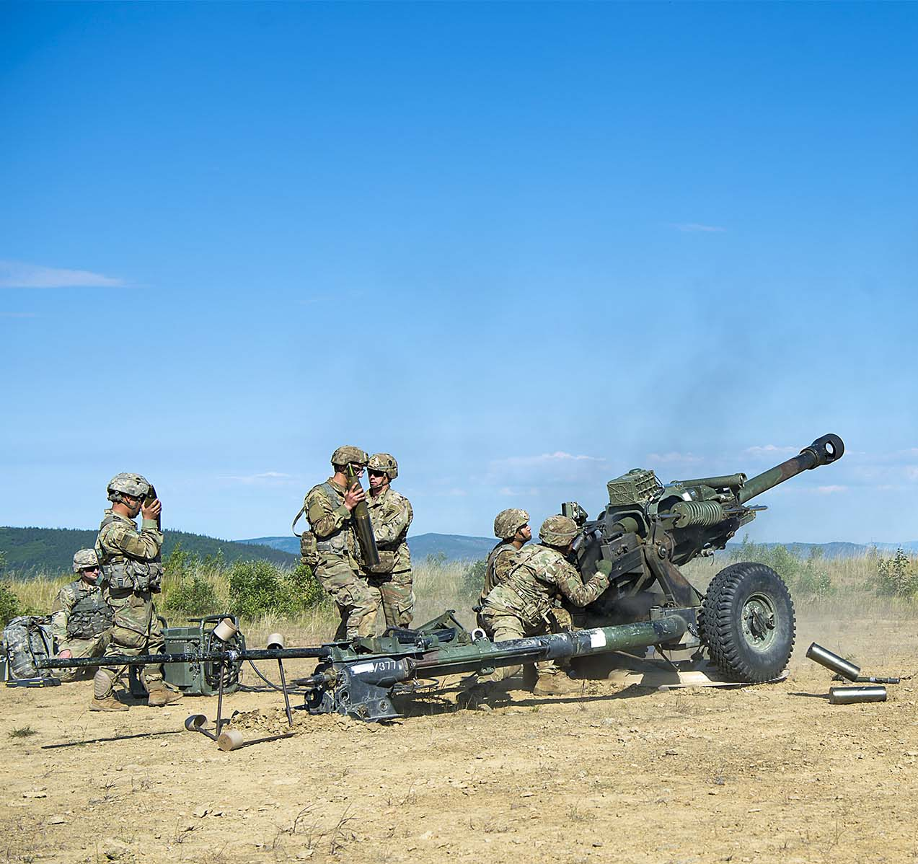
Army Team Building
Army team building, a continuous process of enabling a group of people to reach their goals and improve their effectiveness through leadership and various
exercises, activities, and techniques.
The goal of team building is:
Improving the quality of the team
Improving how well the team works together to accomplish tasks
FM 6-22 para 1-21

Slide 8
The Army Team Building Process
Formation
Enrichment
Sustainment
Enables groups of people to meet their goals
Team building is essential for the Army to function and perform
Success for the team requires the cooperation of every member
The goal is to improve the quality of the team and how it works together to accomplish the mission.
The Army's process for team building includes forming, enriching, and sustaining teams
ATP 6-22.6 para 1-6

Slide 9
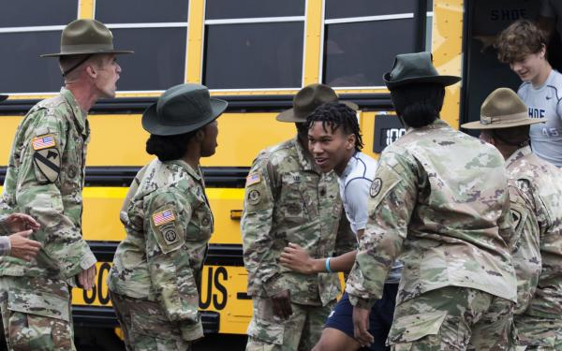
Formation Stage
The three critical components of formation are:
Assembling the team
Building trust
Communicating effectively
ATP 6-22.6 Chapter 2

Slide 10
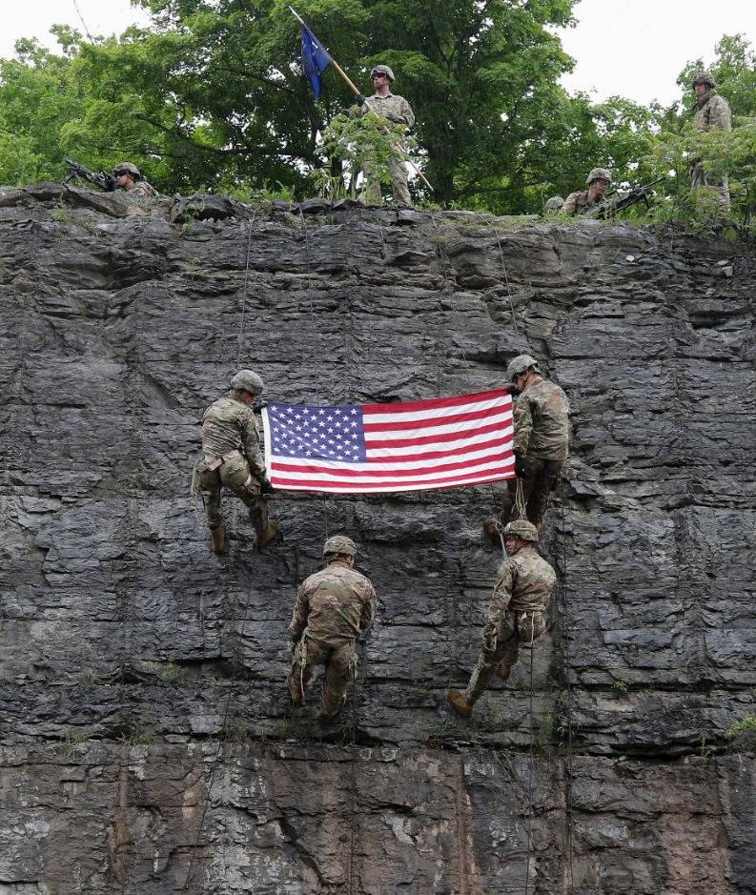
Enrichment Stage
The process of enhancing teamwork by:
Building commitment to the team
Building competence in task accomplishment
Building shared confidence as a team
Motivating each other to excel
Building shared accountability by holding each other accountable
Developing cohesion by working together to accomplish tasks
ATP 6-22.6 Chapter 3

Slide 11
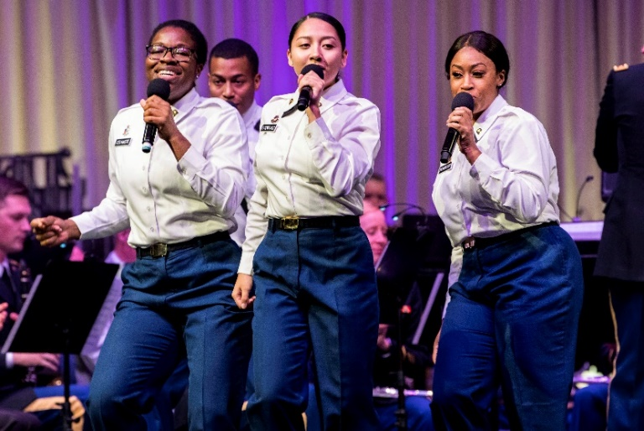
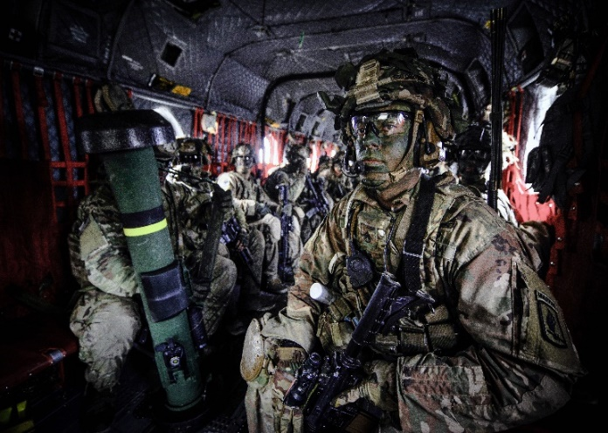
Sustainment Stage
Teams overcome adversity by:
Adapting to changes
Managing conflicts
Sustaining resilient mindsets
Recognizing diversity as a strength
ATP 6-22.6 Chapter 4

Slide 12
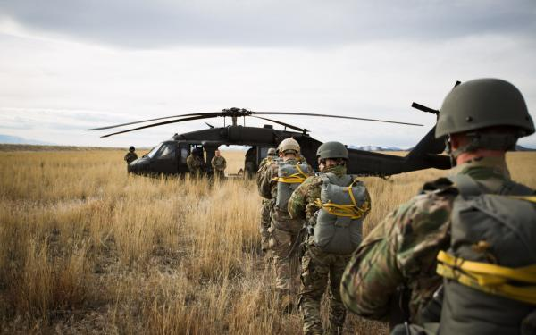
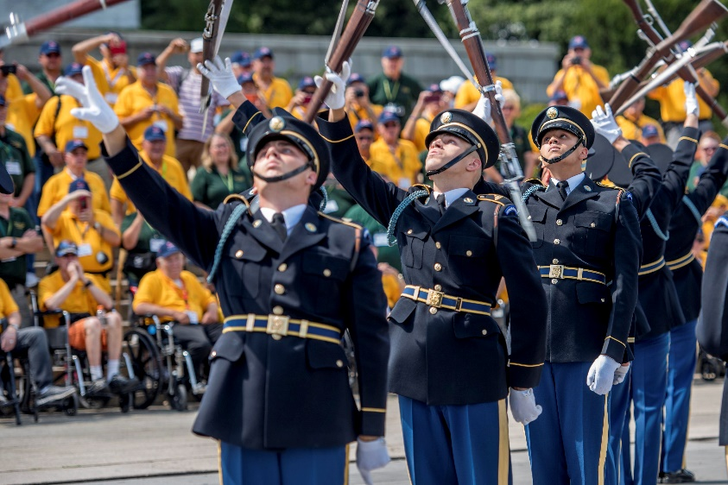
Characteristics of Effective Teams
Trust each other and being able to predict what each will do
Work together to accomplish the mission
Execute tasks thoroughly and quickly
Meet and exceed the standard
Adapt to demanding challenges
Learn from their experiences

Slide 13
Indicators of Team Effectiveness
Ineffective Teams
Fail to listen to relevant input of a team member
Speak despairingly about other members
Fail to enforce or encourage discipline in the team
Compete, rather than cooperate with other team members
Argue with other team members in front of counterparts or other individuals
Fail to act to make decisions on issues that implications on the team
Focus more on self-interest than the well being of the team
Give less than full effort because of low morale or lack of confidence in other team members.
Effective Teams
Emphasize what is common among members rather than focus on characteristics that could subgroups to form
Hold a share vision about operating as a team
Share information that may be useful to other team members
Ensure team members periodically engage in group
Act quickly to promote togetherness when schisms in the group appears or morale drops
Show appreciation and concern for other team members
Act as a team instead of individuals, take pride in teams accomplishments

Slide 14
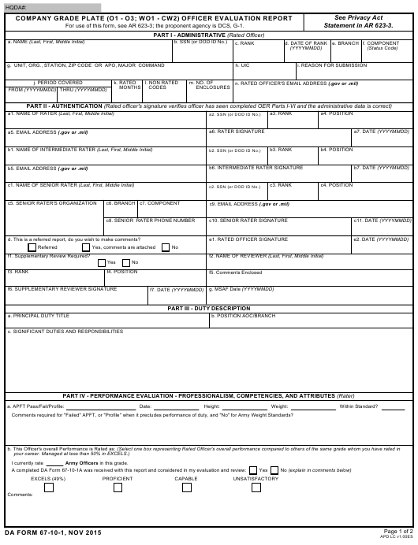
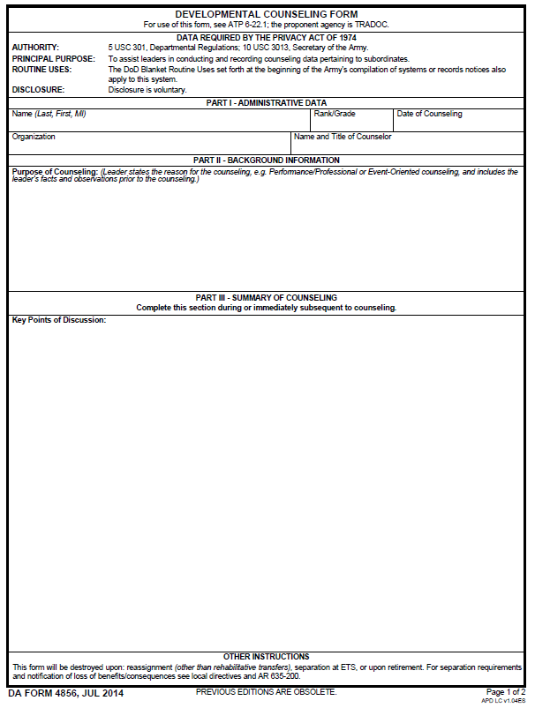
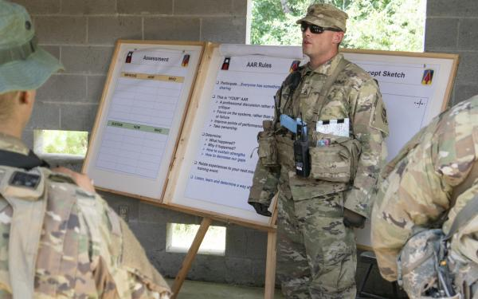
Assessing the Team
Individual Assessments:
Performance counseling
Evaluations
Team Assessments:
After Action Reviews
ATP 6-22.6 Appendix A

Slide 15
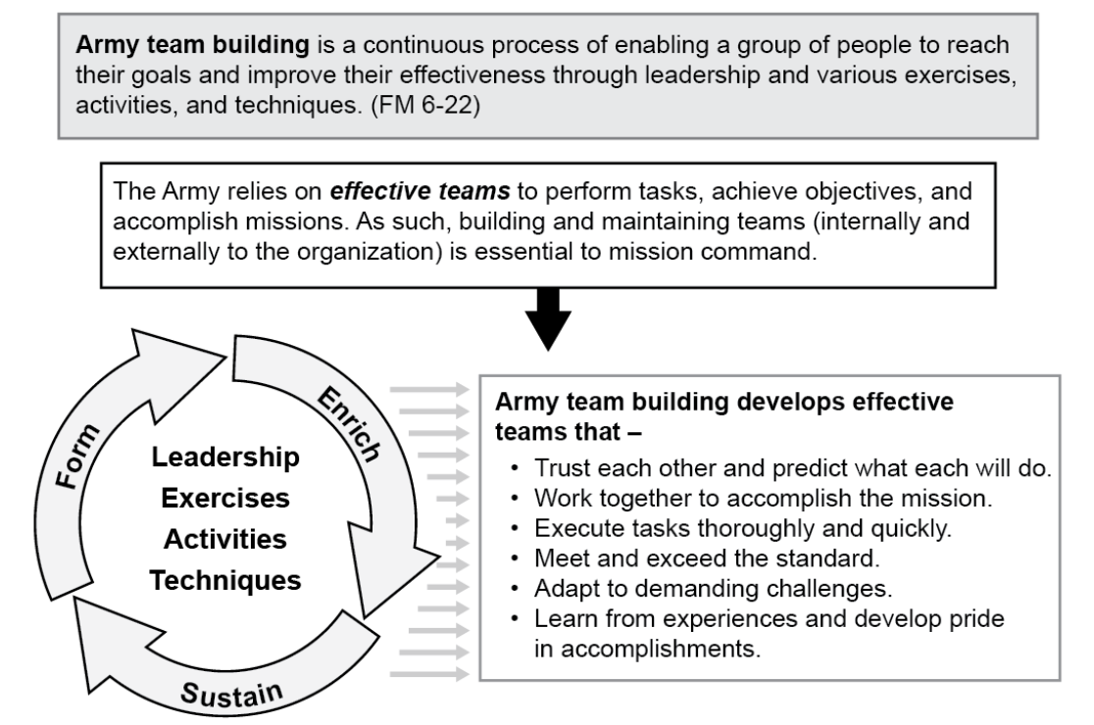
Questions

Slide 16
CAPL Training and Education Resources

