Slide 1


Leader Development
158-SCP0001
Company Commander / First Sergeant Course

Slide 2
Terminal Learning Objective
Action: Demonstrate Command Responsibility for Leader development
Conditions: As an incoming company commander or first sergeant attending the pre-command course; given classroom instruction, peer-to-peer discussion, instructor feedback, reflection time, and references such ADP 6-22, ATP 6-22.1, ATP 6-22.6, and FM 6-22; and the requirement to perform the responsibilities associated with the Army Profession.
Standards:
Define leader development in a clear and concise manner.
Identify at least three tenets of leader development.
Review the components of the Leadership Requirements Model [three attribute categories and three competency categories].
Review the five steps of the operations process.
Identify the four fundamentals of development.
Identify the four characteristics of program development.
Identify the three types of counseling.
Identify the three stages of the team building process.
Learning Domain: Cognitive
Level of Learning: Apply

Slide 3
GEN James C. McConville, 40th CSA
Leaders have a directed responsibility to develop their subordinates.
At the Army Profession Forum in December 2019, GEN James C. McConville, the 40th Chief of Staff of the Army (CSA), stated his philosophy in a speech [People First, Army Priorities (readiness, modernization, reform), and Winning Matters].
He tied readiness at the tactical level to cohesive teams that are highly trained, disciplined, and fit. He then elaborated on building cohesive teams and explaining his concept of, ‘This is my squad.’
His comments reinforced how leader development programs contribute to unit cohesion, resilience, and agility to improve readiness.

Slide 4
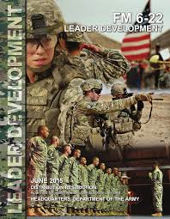
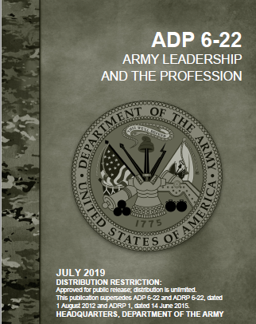
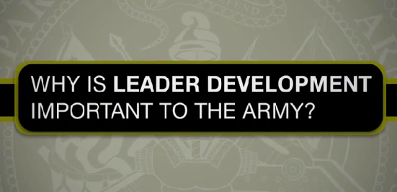
Leader Development Doctrine
Provides a common framework in language and expectations
Defines a fundamental set of leader attributes and competencies common to all cohorts and leader levels
Aligns leader development activities (institutional, operational, and self-development domains)

Slide 5
Leader Development Tenets
• Strong commitment by the Army, superiors, and individuals to leader development
• Clear purpose for what, when, and how to develop leaders
• Supportive relationships and culture of learning
• Three mutually supportive domains (institutional, operational, and self-development) that enable education, training, and experience
• Providing, accepting, and acting upon candid assessment and feedback

Slide 6
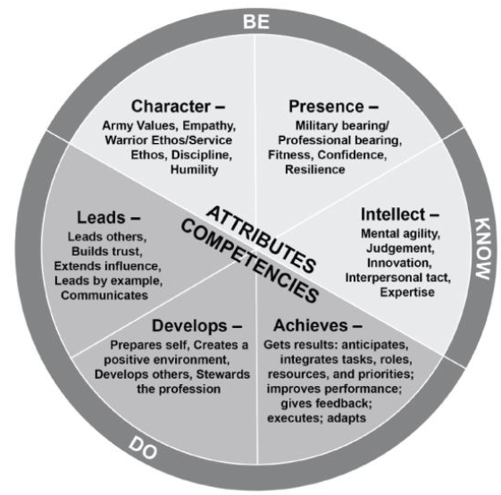
Leadership Requirements Model
Illustrates the expectations of every leader (NCO, Officer, DA Civilian)
Attributes: the desired internal characteristics of a leader (Be/Know)
Competencies: skills and learnable behaviors the Army expects leaders to acquire, demonstrate, and continue to enhance (Do)

Slide 7
Program Development
• Is a Command responsibility
• Must nest with higher headquarter’s guidance
• Defines roles and responsibilities
• Uses the Operations Process
Operations Process

Slide 8
Program Development - Understand
Use formal assessments and/or leader observations
Develop a vision statement
Establish goals and an end state

Slide 9
Program Development – Plan/Prepare
Selection of leader development activities
Program that fits both individual and unit schedules
Formal, semiformal, and informal practices

Slide 10
Program Development – Execute/Assess
Leader development program as a living document
Unit leader development programs and IDPs
Assessment of vision and end states
Higher headquarters’ responsibilities

Slide 11
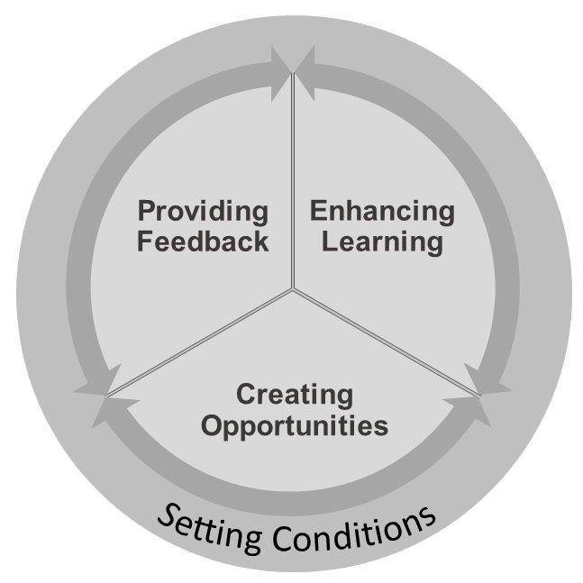
Fundamentals of Development

Slide 12
Setting Conditions
Establishing a culture that promotes leader development
Creating a learning environment
Knowing your subordinates
Building trust and communicating roles

Slide 13
Providing Feedback
Leaders observe subordinates and provide developmental feedback.
Effective feedback accelerates subordinate development.
Leaders should provide immediate feedback that encourages positive behavior.
Time and frequent observations help leaders build confidence.

Slide 14
Enhancing Learning
Positive role models and emulation of leadership behaviors
Benefits of mentorship
Guided discovery learning
Study of the profession

Slide 15
Creating Opportunities
Create challenging experiences to create a culture of development.
Leaders foster an attitude that leadership positions are not automatic appointments.
Succession is a developmental activity that should be planned.
Track career development and management.

Slide 16
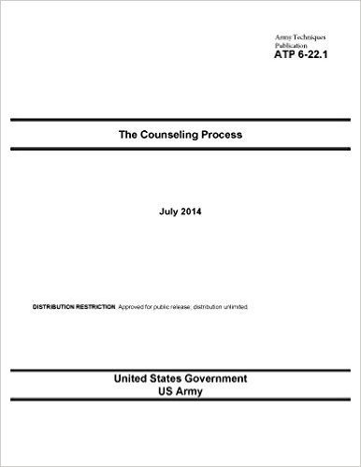
Counseling
Types of Counseling
  Event
  Performance
  Professional Growth
Fundamentals of Counseling
  Counselor qualities
  Counseling practices
  Accepting limitations
  Addressing resistance
  The four-stage counseling process
  Counseling approaches and techniques

Slide 17
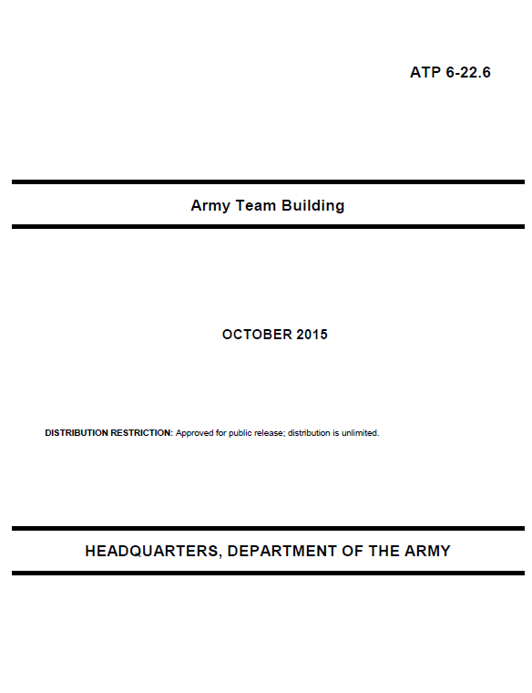
Team Building
Team building stages
  Formation
  Enrichment
  Sustainment
Categories
  Internal teams
  External teams

Slide 18

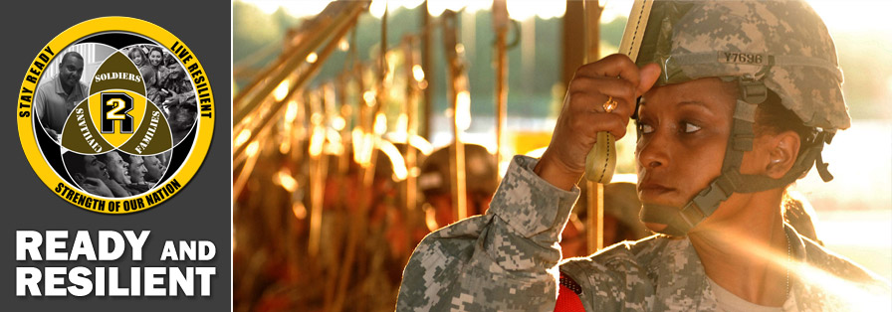
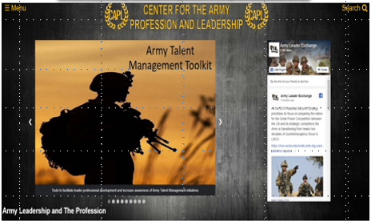
Leader Development Tools
Center for the Army Profession and Leadership
  https://capl.army.mil
Army Career Tracker
  https://actnow.army.mil
Army’s Ready & Resilient Campaign
  www.army.mil/readyandresilient

Slide 19
Summary
Leader Development is your responsibility.
Use doctrine, available tools, and other publications to guide your program development and implementation.

Slide 20
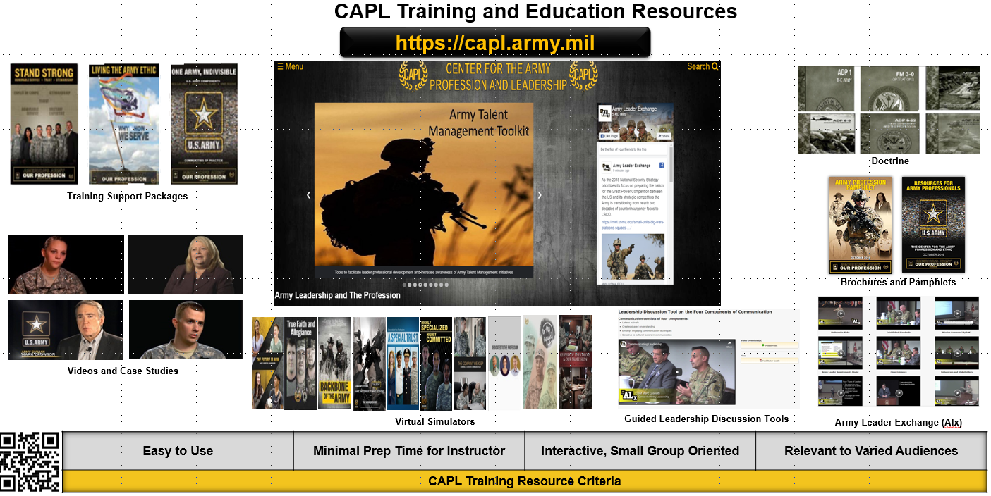
Center for the Army Profession and Leadership Resources

