Slide 1
158-DSA0003
Challenge and Motivation

Slide 2
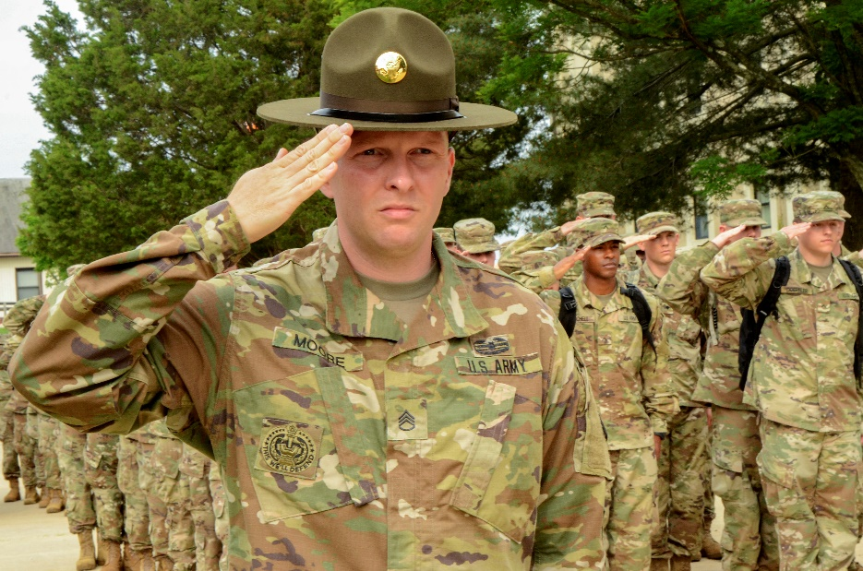
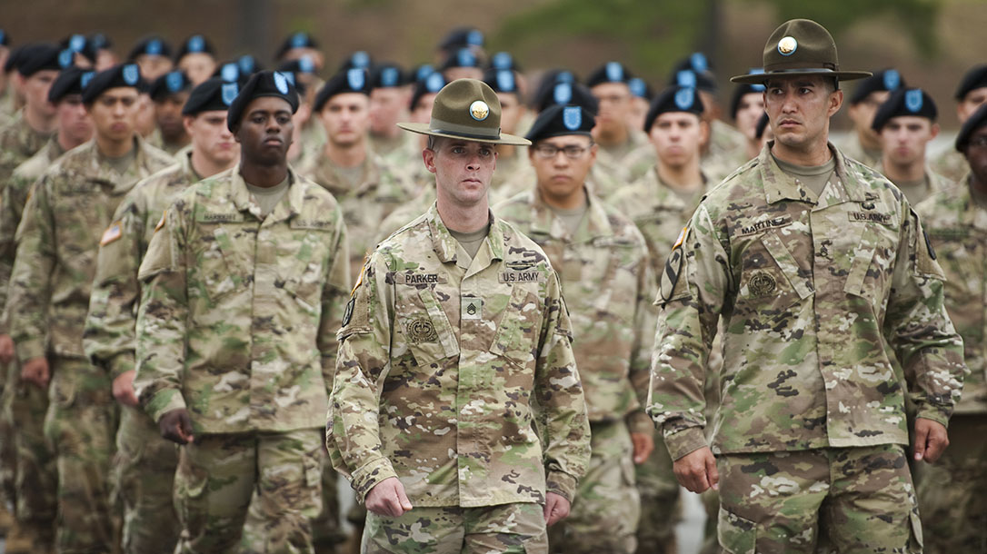
Inspiration
How do you inspire a diverse group of people, fresh out of the civilian world, to not only engage in tough, stressful, and tiring tasks, but to do so with enthusiasm?
Notes:
Keep as CE.

Slide 3
Terminal Learning Objective (TLO)
Action: Review challenge and motivation.
Conditions: As a candidate at the United States Army Drill Sergeant Academy, given experiential learning activities and access to references ADP 6-22 and TR 350-6, discussion with peers and instructor feedback, and reflection time.
Standards:
Define self-fulfilling prophecy in a clear and concise manner.
Identify the two types of motivation.
Identify at least five trends for the IET population.
Learning Domain: Cognitive
Level of Learning: Comprehension

Slide 4
What we know about IET Soldiers: Social
Average Age……………………...... | 22 (17 – 42)
Education…………………………… | 18% GED, 41% HS Diploma, 33% Some College, 7% Four-Year College Degree
Marital Status………………………. | 77% Single, 20% Married, 3% Divorced/Separated
IET Soldiers with Children………… | 24% have at least one child
Single-Parent IET Soldiers……….. | 9%
IET Soldiers before BCT………….. | 24% Attending School, 57% Working, 13% Seeking Work, 3% Stay-at-Home Parent, 3% Nothing at All
IET Soldiers in JROTC……………. | 15%

Slide 5
What we know about IET Soldiers: Physical
In Team Sports/Fitness Activities before BCT…………............. | 48%
Tried to Lose Weight before BCT…………………………..……… | 48%
Tried to Gain Weight before BCT…………………………..……… | 21%
Tried to Eat Right before BCT……………………………………… | 76%
Tried to Improve Run before BCT……………………………....…. | 48%
Tried to Improve Strength before BCT………………….………… | 70%

Slide 6
Self-Fulfilling Prophecy
The term “self-fulfilling prophecy” (SFP) was coined in 1948 by Robert Merton.
SFP is a false definition of the situation evoking a new behavior which makes the originally false conception come true.
When Drill Sergeants believe media hype:
Problem Soldiers stand out.
DS see them as snapshot of entire PLT.
DS expectations and Soldier behavior change.
Soldiers lose faith in themselves and other Soldiers.
They stop trying.
Demotivation occurs.

Slide 7
Moving Beyond Media Myths:
Why Soldiers Enlist
To Support My Family/Myself*……............................................ | 38.5%
To Learn Discipline/Challenge Myself……………………………. | 28%
To Serve My Country/Be A Soldier………………………………... | 25.5%
For the Bonus…………………………………………………………. | 4.5%
Family Tradition/To make my Parents Proud……………………. | 1.9%
Boredom/Escape from Home………………………………………. | 1.6%
WHY Soldiers come into BCT affects HOW they come out...
*Includes “to earn money for college”

Slide 8
Two Types of Motivation
Extrinsic
Intrinsic
Occurs when we perform a behavior or engage in an activity to earn a reward or avoid punishment.
Occurs when we perform a behavior or engage in an activity because it is personally rewarding.
You can’t change the reason why they joined the Army…
But…
You can increase motivation by finding out why your Soldiers joined, and then explaining how they’re meeting those goals in BCT.

Slide 9
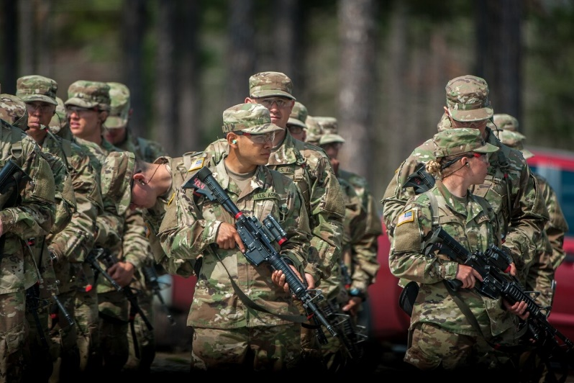
Motivation for IET Soldiers
Motivators
De-motivators
Challenging training
Consistency
Consequences
Light training
Low standards
Leniency
Lax enforcement

Slide 10
Tough or Cruel
Setting high standards Consequences/punishment Criticize + correct Praise when earned/No “easy” go Discipline It’s not done until it’s done right. No excuses | Arbitrarily changing standards Excessive physical punishment Harsh criticism without correction Personal insults/attacks Brutality Never demonstrating “right” Ignoring legitimate Soldier problems/concerns

Slide 11
Drill Sergeant Style and PLT Outcomes
The Drill Sergeants have better PLT performance when they maintain:
Toughness & Discipline | Challenge & Engagement
Are tough Are strict Demand a lot from trainees Enforce the standards Set high standards | Challenge Soldiers to do their best Don’t give up on Soldiers who are trying Seem like they (DS) want to be here Seem to know what they (DS) are doing Really care about training Soldiers Are motivated to set an example

Slide 12
AAR / Summary

Slide 13
CAPL Training and Education Resources

